Slide 1


Team 2:
Yash Modi
Owen Laing
Bailey Liang
Abbas Vaziri
Milin Vaniyawala
Hanze Liu

Slide 2
Autonomous Driving Cars

Slide 3

Functionality
This will be a core system useable by other systems in BrickMMO. This system lets a user point a location to the vehicle, then the vehicle will drive to that location automatically.

Slide 4

Dependency
This system will be dependant on : GPS System
Charging system
Speed-Control system
The LEGO Group. (n.d.). Boutique Hotel. Retrieved 2022, from https://www.lego.com/en-ca/product/boutique-hotel-10297.

Slide 5
3. Settings and Info

Slide 6
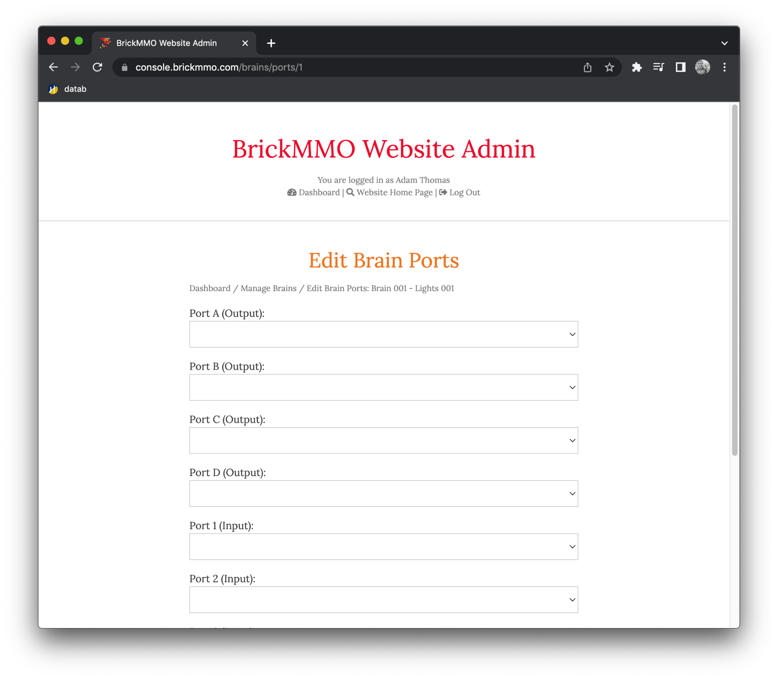
Settings & State
Vehicle ID : Unique ID for API calls Vehicle state : On / Off
Destination : GPS Location
Route Traffic : Retrieve from GPS
Battery Level : 0 - 100%

Slide 7
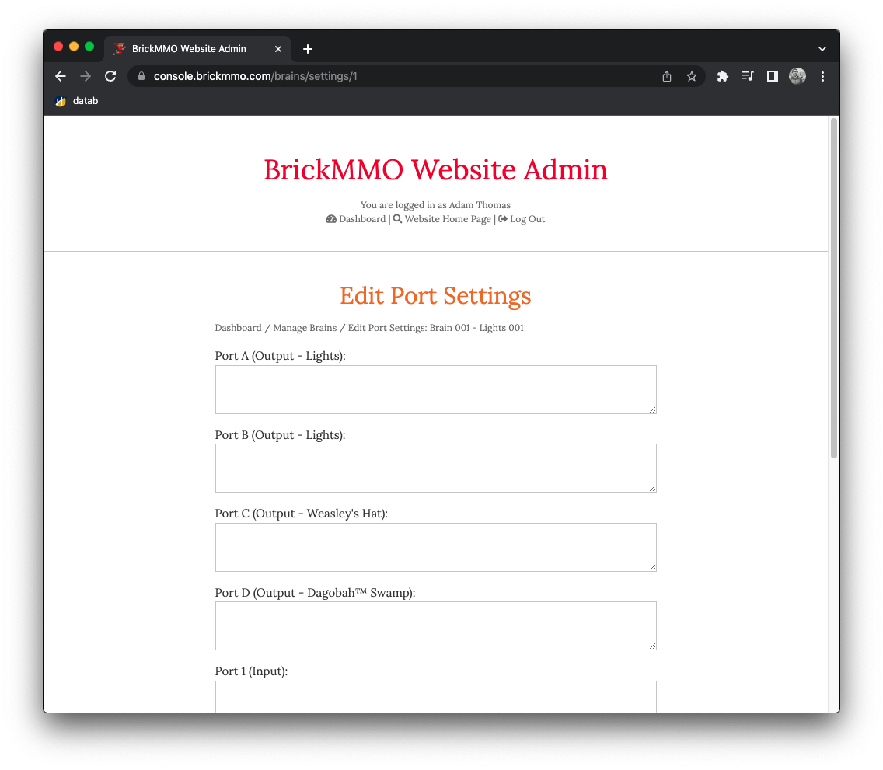
Module Input / Output
Input: Destination : GPS Location
Output:
Shortest Path to Destination : Route
Estimated time to Destination : Integer Has enough charge to reach Destination : Boolean

Slide 8
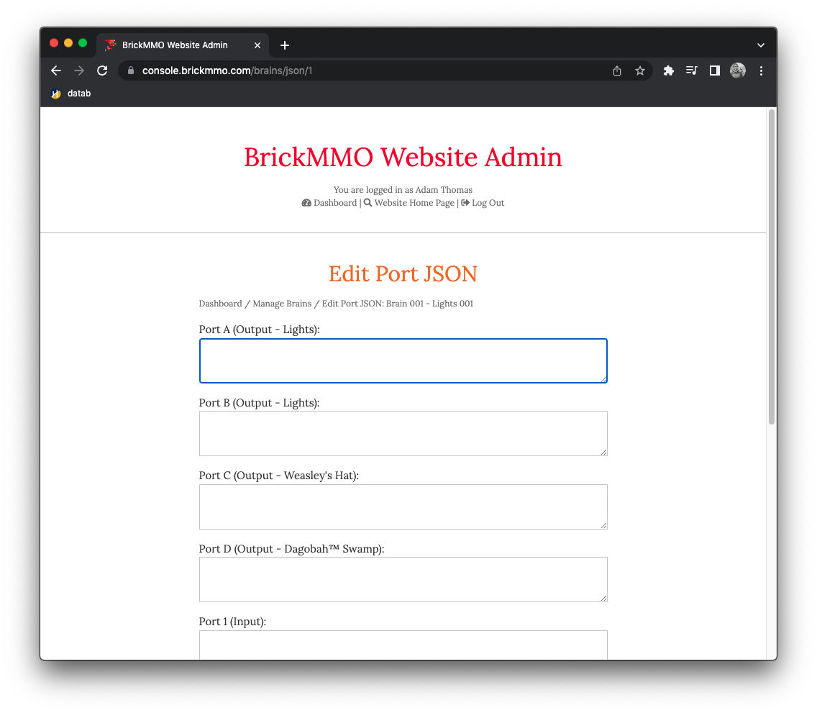
Possible Integrations
This core system can possibly be integrated into a future public transit system, or ride share like Uber.
{"buildings" : [1]}

Slide 9
4. Ports, Motors, and Settings

Slide 10
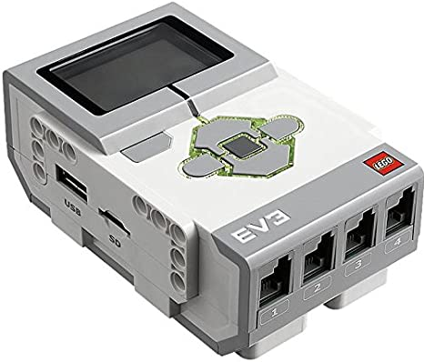
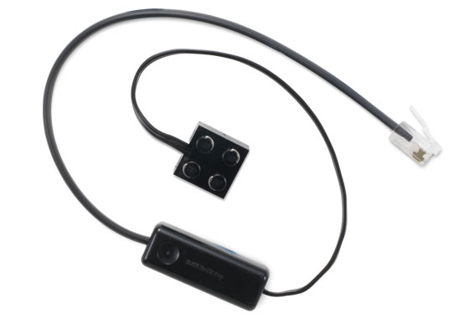
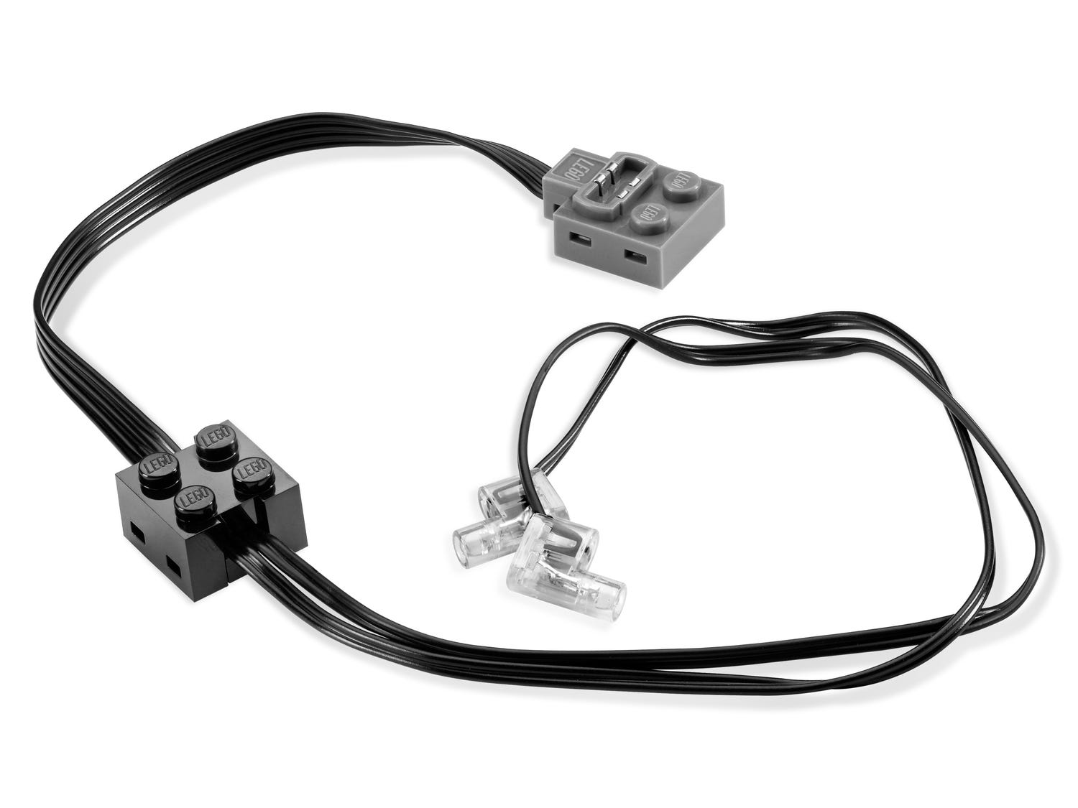
Sensors and Motors
EV3 Hub (Brain, receives inputs)
EV3 Medium Motor to turn infrared sensor
EV3 Large Motor for accelerating / stopping / turning
Infrared Sensors / Radar (Measure distance to nearby objects, aid in maneuvering)

Slide 11
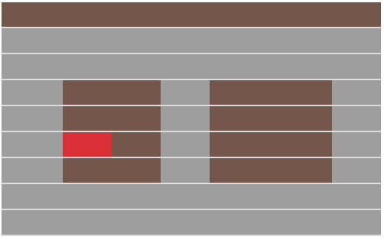


Admin Control Panel
Managing vehicle condition
Checking battery
Checking sensor
Parking spot

Slide 12
5. Pseudocode

Slide 13
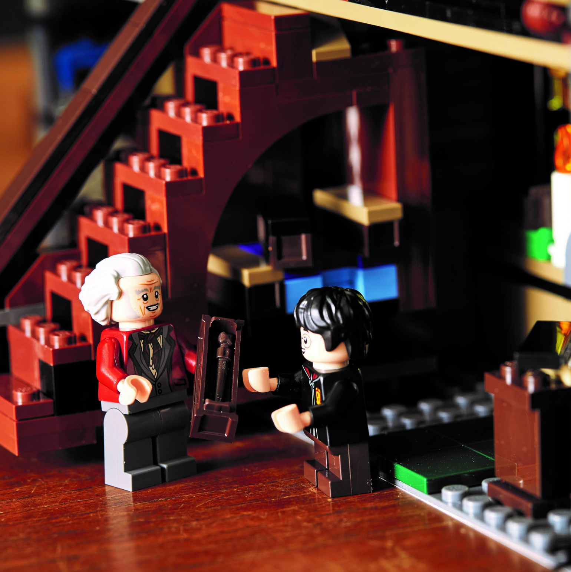
IOT Loop
if carCharged:
set coordinates;
while reachedToCoordinates:
if obstacle || traffic signal
slowDown or stop;
else if emptyRoad
maintainSpeed;
else:
Use chargingStation;
The LEGO Group. (n.d.). Diagon Alley™. Retrieved 2022, from https://www.lego.com/en-ca/product/diagon-alley-75978.

Slide 14
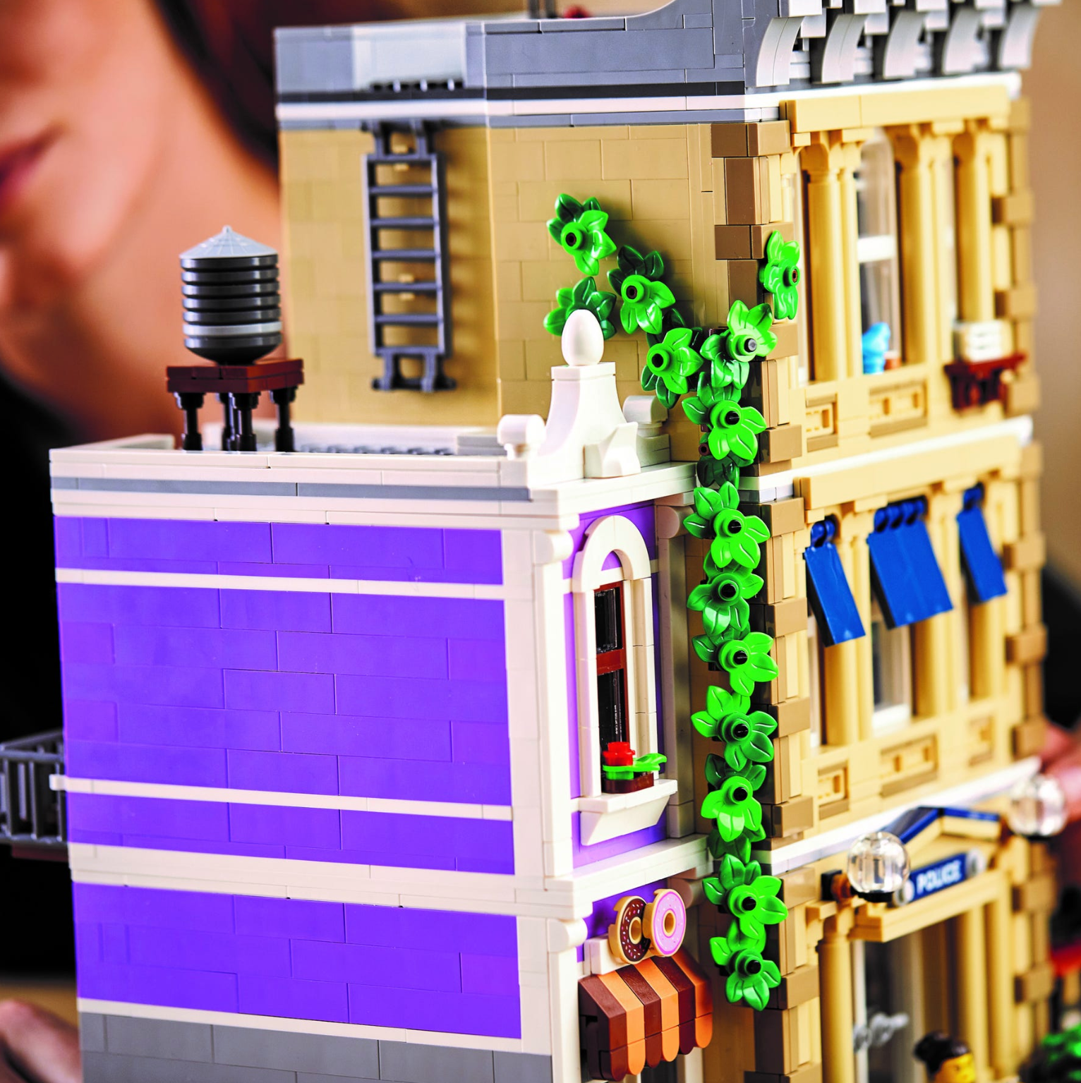
API Endpoints
/api/vehicle/info/{vehicle-id} Returns the vehicle information of the specified vehicle. E.g Battery Percentage, Estimated time to location, etc.
/api/vehicle/destination/[vehicle-id]/{gps-location}/ Tells the specified vehicle id to goto the specified location.
The LEGO Group. (n.d.). Diagon Alley™. Retrieved 2022, from https://www.lego.com/en-ca/product/diagon-alley-75978.

